Slide 1

Power System Management
Week 8
1714949

Slide 2
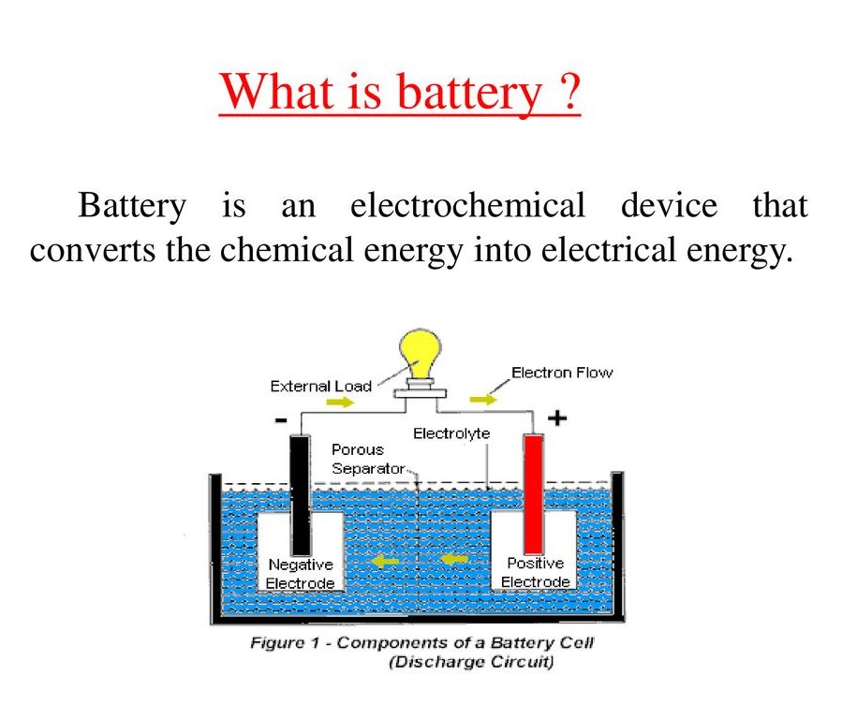

Slide 3
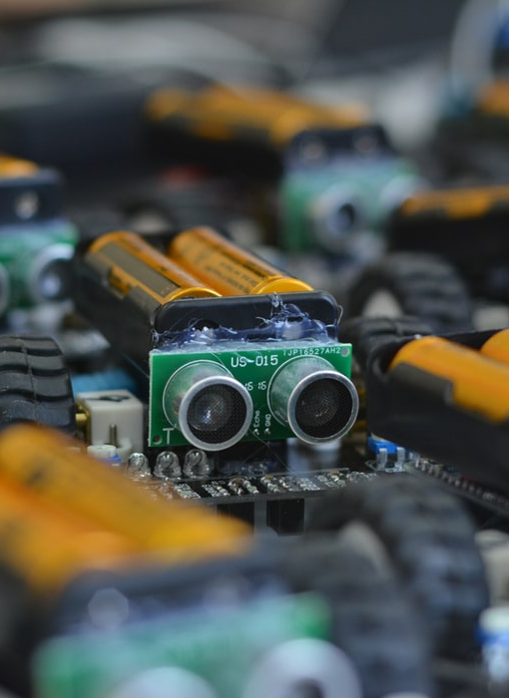
Types of batteries used for robots and Prices
Choosing the right battery system for your robots is essential because each type requires a different type of battery. Some require smaller sized ones while others could require larger ones. And then we talk about the varieties of batteries. Here’s a detailed guide on the types of battery systems for robots

Slide 4
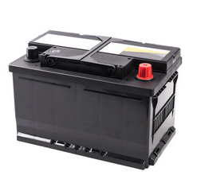
1. Lead-Acid Batteries
Lead-acid batteries are usually cheap and come in large capacities too. You can find them in larger platforms that don’t require tremendous power but need lots of energy capacity. You’ll find them in solar power systems, UPS, etc. However these are only available in increments of 6V and 12V, are super heavy and have low capacity per weight unit. They also take longer periods of time to charge and lose capacity if left in storage.

Slide 5
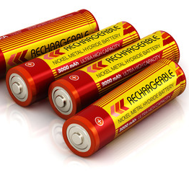
2. Nickel Metal Hydride Batteries
nickel-metal hydride batteries are the ones for you. They’re quite popular for their low internal resistance and the good power-to-weight ratio and are far safer than Lithium-based cells. You’ll find them in airsoft guns, cheap toys, AA/AAA replacements, digital cameras, etc. Disadvantages include a higher self-discharge (around 50% higher than NiCd). They also have a limited service life and do not absorb over-charge well.

Slide 6
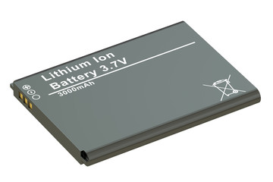
3. Lithium-Ion Cells
Lithium-Ion Cells are relatively safe and have a higher energy density so they are suitable for electronic equipment that requires longer time between charges while still consuming more power. Their rates of self-discharge are also low and are very lightweight. They’re used in powering electronic gadgets such as mobile phones, laptops, and tablets

Slide 7
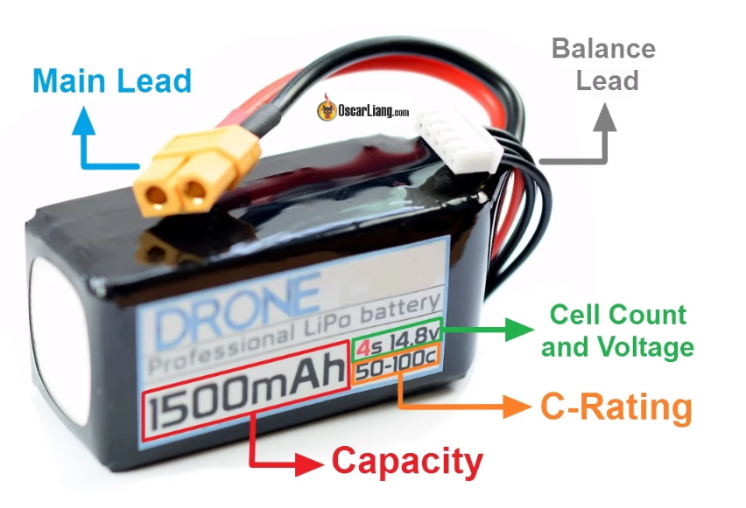
Battery Ratings:
All batteries will come with a list of voltage ratings and capacity ratings in amp-hours or milli-amp hours. Some will also come with a discharge current rating (C-rating) or burst current rating.

Slide 8
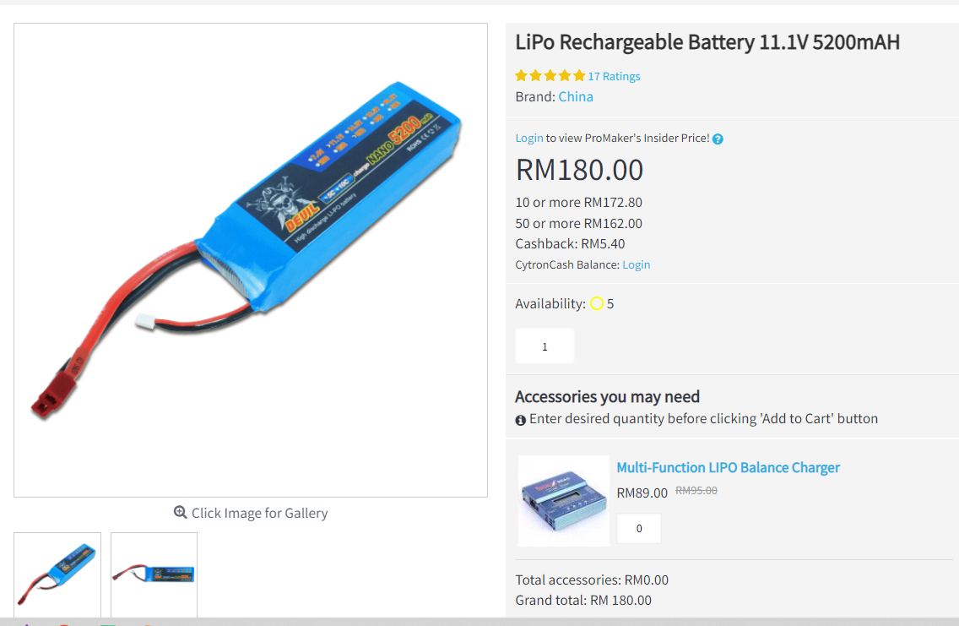
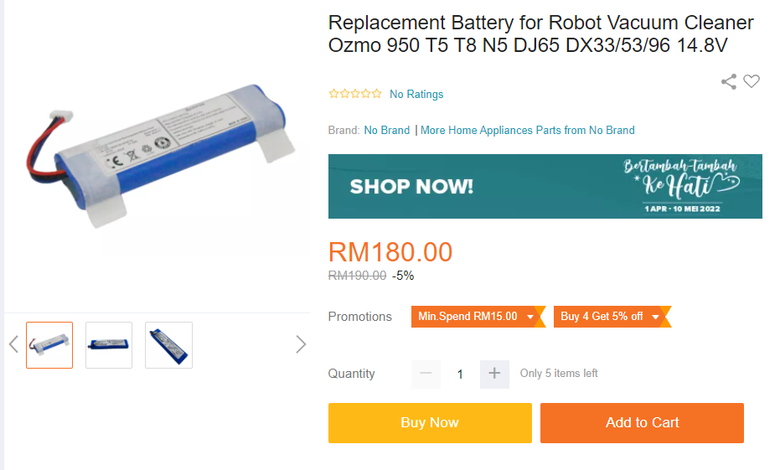
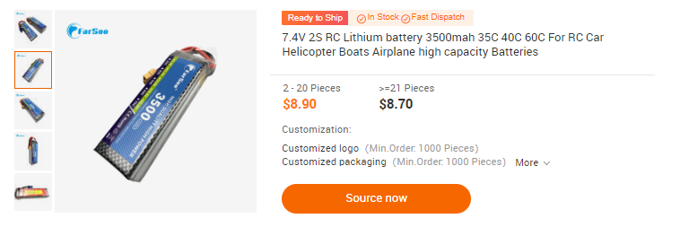
Brands and Prices

Slide 9
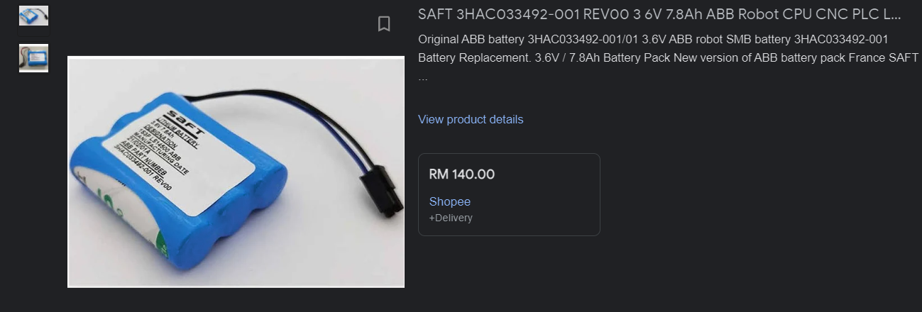
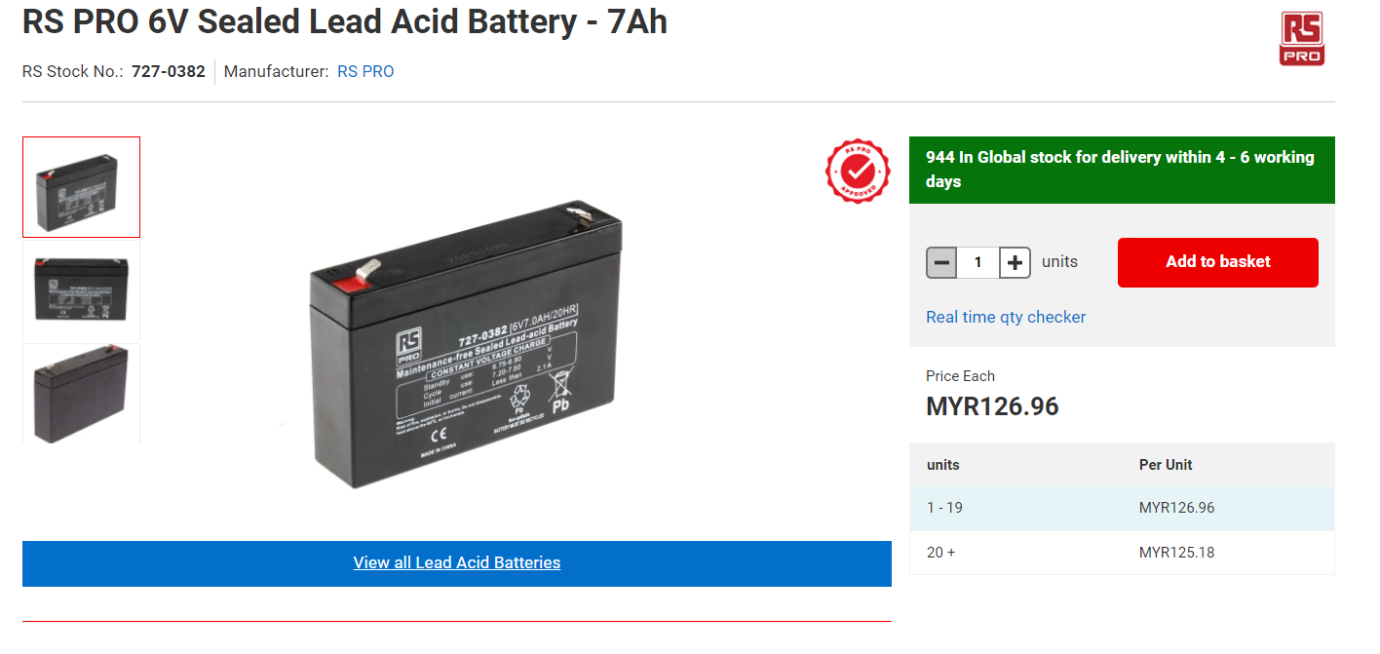
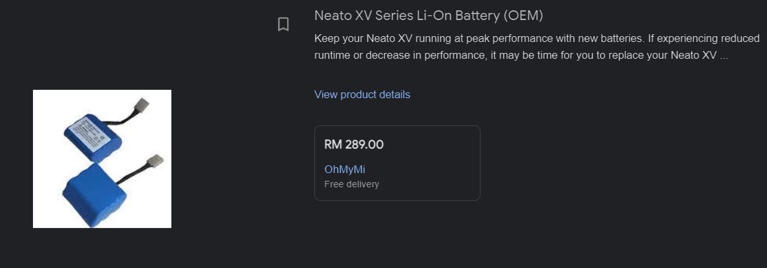

Slide 10
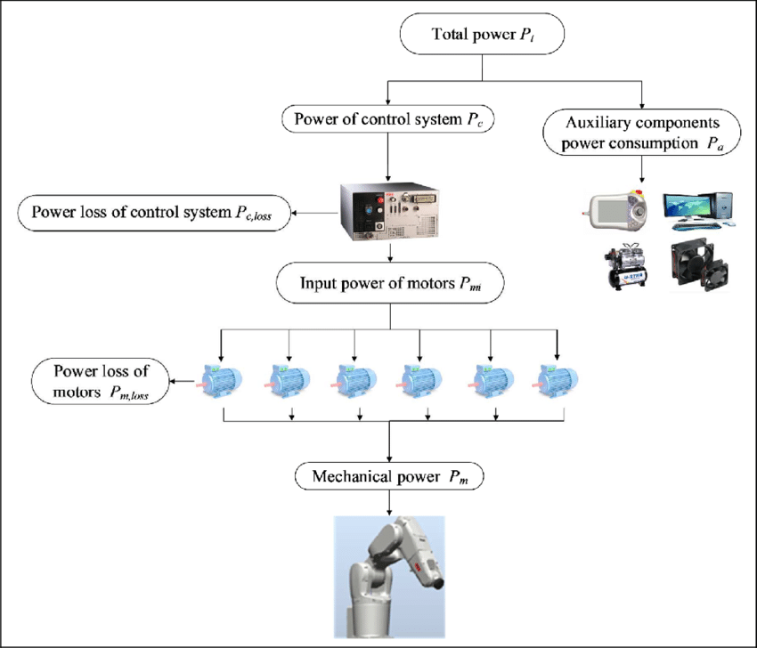
Energy flow of the industrial robot.

